Slide 1

The Patient Protection and Affordable Care Act October 3, 2012 U.S. Conference on AIDS
Amy Killelea, JD Anne Donnelly John Peller
National Alliance of Project Inform AIDS Foundation
State & Territorial of Chicago
AIDS Directors

Slide 2

State Health Reform Implementation: Where the Rubber Meets the Road
Amy Killelea, JD National Association of State and Territorial AIDS Directors
akillelea@NASTAD.org
(202) 434-8054
Notes:
*

Slide 3
ACA Advocacy Imperatives: The Big Three
Ensure that every state expands Medicaid in 2014
Ensure that the benefits requirements in both Medicaid and private insurance meet HIV prevention, care, and treatment needs
Ensure that exchanges are designed and implemented in ways that incorporate HIV providers and expertise and ensure continuity of care

Slide 4
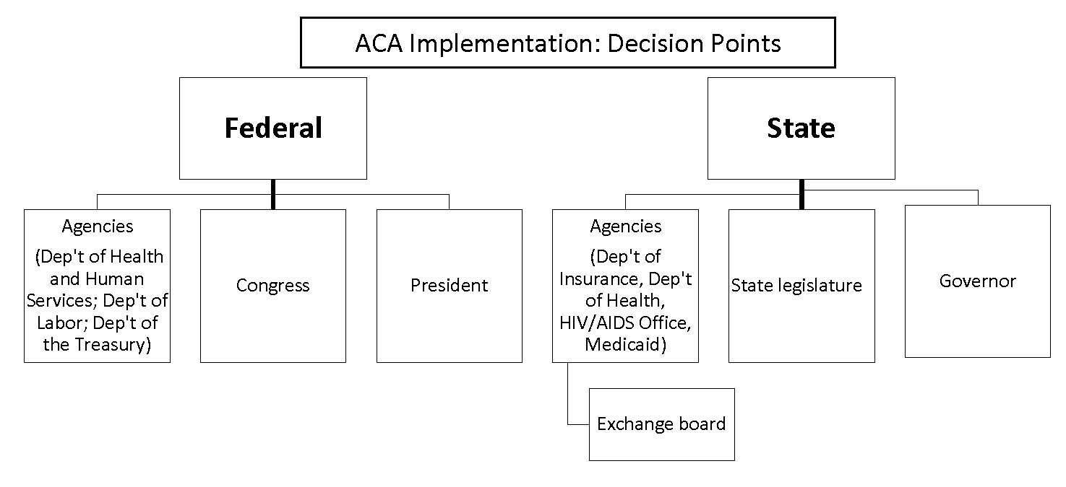
Health Reform Decision Points
Source: Treatment Access Expansion Project, May 2012

Slide 5
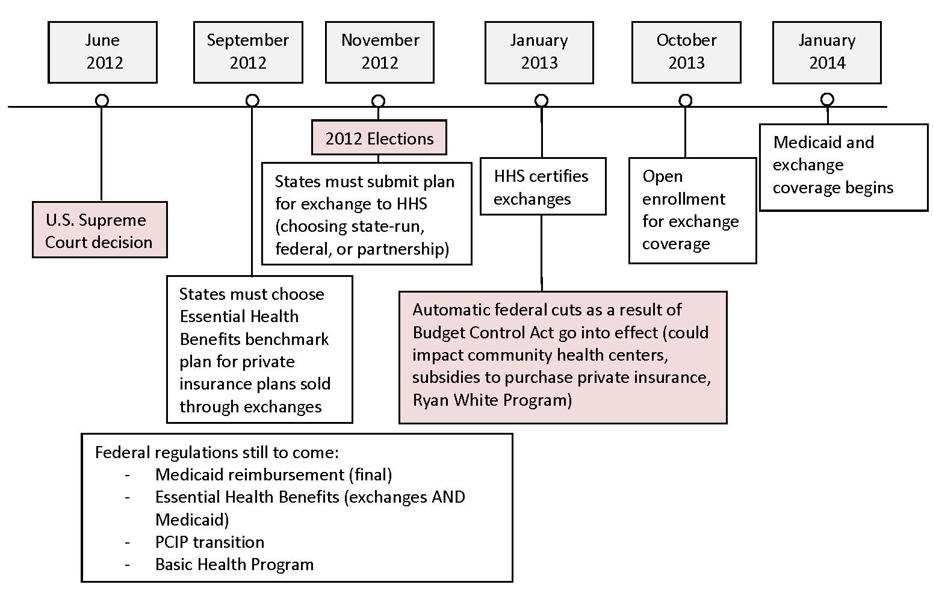
Health Reform Timeline
Source: Treatment Access Expansion Project, May 2012

Slide 6
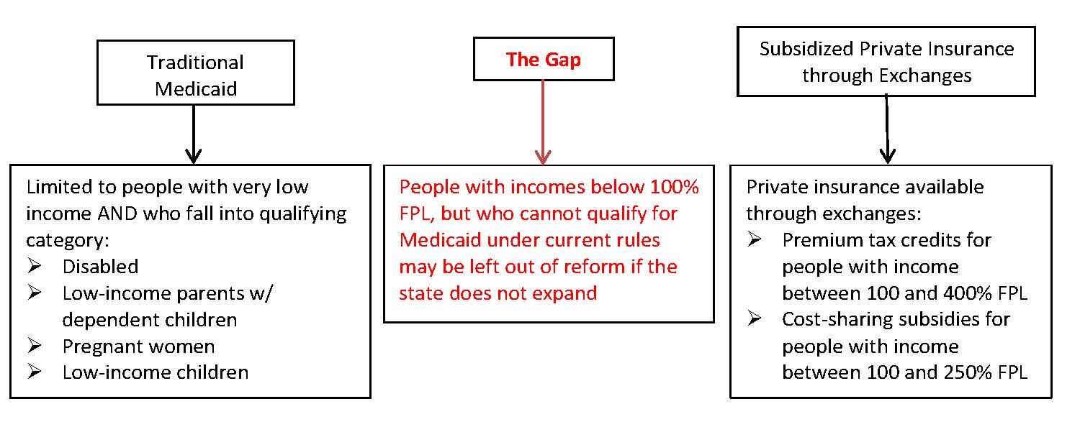
1) Ensure that Every State Expands Medicaid in 2014
What happens in a state that does not comply with expansion?

Slide 7
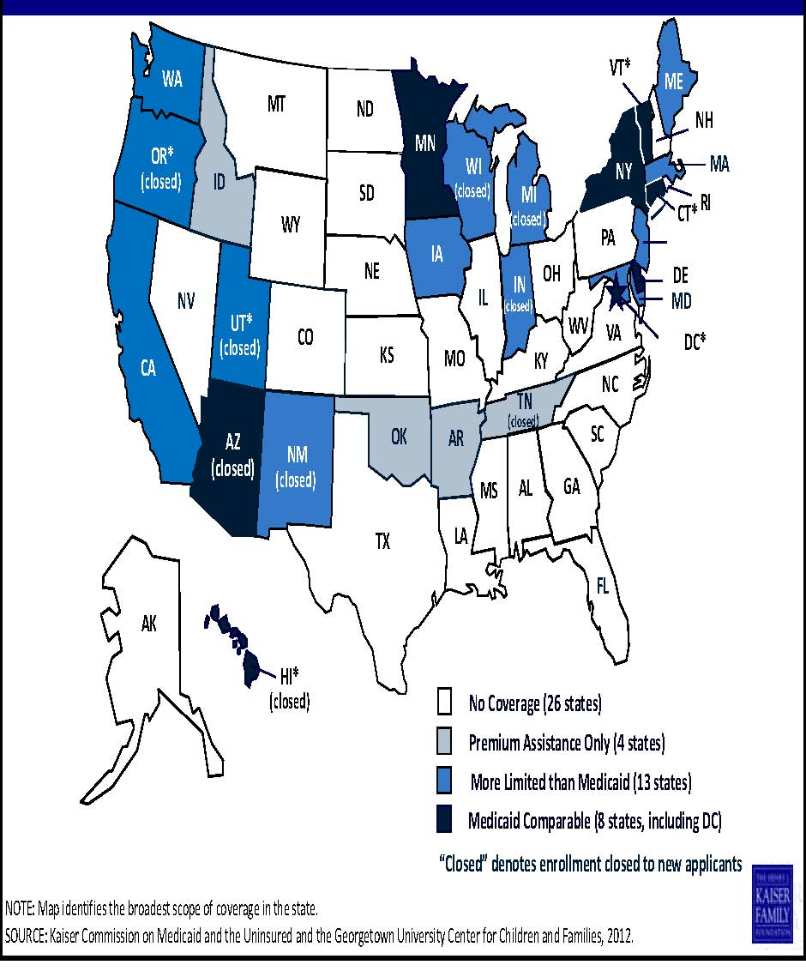
States with Most Restrictive Medicaid Programs Have Most to Gain from Expansion
Medicaid Coverage of Low‐Income Adults, January 2012

Slide 8
2) Ensure that Benefits Requirements Are Comprehensive
Essential Health Benefits (EHB)
States must provide newly eligible Medicaid beneficiaries and people insured in the individual and small group market with “benchmark” coverage (based on private insurance market)
Benchmark coverage must include the ten categories of EHB services
For Medicaid, benchmark coverage must also meet existing Social Security Act requirements and protections

Slide 9

Why Does Benchmark Coverage Matter?
Ongoing Concerns for Private Insurance EHB Benchmark:
Current prescription drug requirements are weak (plans must cover only one drug in each class)
Service limits and utilization management techniques may continue
Medicaid benchmark plans have been used by states to offer slimmer benefits packages:
Wisconsin BadgerCare Core Plan:
Restricted formulary
No branded ARVs

Slide 10
3) Be at the Table as Exchanges are Designed and Implemented
Exchange Establishment
Options for exchange implementation:
State-based exchange (16 states and DC so far)
Federally-facilitated exchange
Partnership/hybrid model
ALL exchanges must have:
Outreach/patient navigator programs
Plan certification criteria (including network adequacy standards)
Interface w/Medicaid

Slide 11
Community Preparation
Ongoing state implementation issues
Continuity of care and payer of last resort compliance
Infrastructure to serve an insured population
Community Health Centers
Private physicians
Public hospitals (DSH, county, state)
HIV System
of Care
Community-based organizations
Non-physician providers
University hospitals

Slide 12
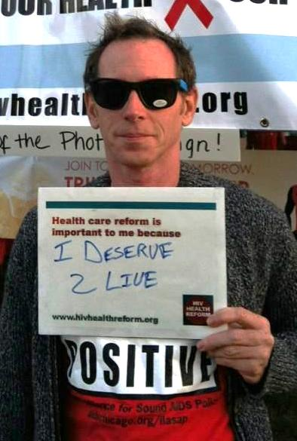
Health Care Reform A California State Perspective
Anne Donnelly, Project Inform
adonnelly@projectinform.org
415.558.8669 X208
Notes:
*

Slide 13
State Advocacy and Planning Matters
Many, if not, most key health care reform decisions will be made at the state level
Federal government sets framework; states operationalize
Every state is on a different timeline
Different populations
Different political and fiscal realities
People with HIV and their providers face a unique challenge
Mandatory transition from Ryan White to new care system
Ensuring continued delivery of comprehensive services
A relatively small population in the context of HCR
Notes:
*

Slide 14
Key Decision “Tables” In California
Medicaid Expansion ---> Department of Health Care Services
July 2011 - partial and temporary Medicaid expansion
Still much to do for full expansion in 2014
Multiple stakeholder advisory groups and stakeholder work groups
Got to the table by:
Continuous contact with the Department of Health Care Services;
Engaging the Governor’s office and working with key legislators;
Doing the work & working with other health care advocates
Notes:
*

Slide 15
Key Decision “Tables” In California
CA State Health Benefit Exchange ---> CA Exchange Board
Exchange established and working
Benchmark plan chosen – Kaiser small employer plan
RFP for plans will be sent this month
Multiple stakeholder groups, meetings, webinars & comment solicitation
Got to the table by:
Showing up, speaking up, & making comments
Meeting with staff , Board members and the Executive Director

Slide 16
Key Decision “Tables” In California
Governor’s office and Legislature ---> State statute necessary to establish the Exchange, Medicaid expansion, responsible for costs
Exchange operational; EHB benchmark for the Exchange chosen
Prohibition on pre-existing conditions vetoed
Special legislative session called for December for Medicaid expansion
Got to the table through:
Long standing relationships with staff and other health advocates
Implementing changes in HIV care delivery system ---> no one currently charged with this
Implementation planning for 2014 hasn’t really begun
Working with State Office of AIDS to take leadership
They are not currently funded or staffed to take this on
Even less implementation planning has occurred at the local level

Slide 17
Lessons Learned – State Advocacy & Planning
We have to start now
We can’t do this alone: essential to partner with other low income and disease specific advocates & state administrators
We can’t wait for guidance from HRSA, CMS, CCIIO, HHS etc.
There are multiple decision “tables”
People with HIV, their providers and advocates will likely not be invited to the discussion
It won’t always be clear where or how decisions are being made
There is no one person or agency in charge of these changes for people with HIV
Will require new “roles” for all
Including people with HIV , advocates, providers, agencies
If one approach doesn’t work try another

Slide 18
Lessons Learned – State Advocacy & Planning
HIV specific state entities need to be supported in taking on new roles
The voice of people with HIV in state processes
Medicaid & Exchanges unlikely to have HIV expertise
Collaborate with colleagues in Medicaid services and at the Exchanges
For most this is a new way of working – breaking thru silos
Monitor implementation of Medicaid expansion and Exchanges
Engage with implementation decisions
Develop new programs to secure safe transitions and continuity of quality HIV care

Slide 19
Role of Local Communities
Federal and state agencies will not provide a road map for local areas
Now is the time for everyone to get involved!
Can’t afford to wait for guidance and answers; have to move forward in spite of unknowns
SF forming a HCR task force – goals:
Develop a transition plan for individual, providers and services
Plan for comprehensive service delivery post transition
Plan for clients left out of health care reform
Be strategic - set purpose and goals
Identify client populations and their needs
Identify HIV provider needs
Prioritize the most vulnerable clients and/or providers

Slide 20

Preparing for Health Care Reform in Your Community & Agency
John Peller, AIDS Foundation of Chicago
jpeller@aidschicago.org
(312) 334-0921
Notes:
*

Slide 21
Getting Ready for ACA: The New Landscape
Ryan White Program, SAMSHA, CDC prevention fund aren’t going away, but we will likely see reduced funding in the future
Start preparing NOW for a new environment in our agencies:
Partnerships, Mergers, Collaborations
Our AIDS-specific expertise is a tool that will help Medicaid and private insurance reduce costs and improve health outcomes

Slide 22
How HIV Care is Paid For Today & How It Will Change in 2014
Notes: Based on Patients with HIV Attending Medical Offices Participating in HIVRN; N=19,235. Medicaid includes those with Medicare coverage. Source: Data from K. Gebo and J. Fleishman, in Institute of Medicine, HIV Screening and Access to Care: Exploring the Impact of Policies on Access to and Provision of HIV Care, 2011. Excludes 8% “unknown” coverage.

Slide 23
What services can be reimbursed by Medicaid or private insurance?
Today
Mental health
Substance abuse
Case management or Care coordination
HIV testing
Prevention counseling
Maybe in the future
Peer services
Outreach & engagement
But advocacy & agency infrastructure are needed to ensure ASOs can get reimbursed

Slide 24
Services funded by the Ryan White Program must wrap around other payers

Slide 25
What we’re doing at AFC
Negotiating with a Medicaid managed care company to provide care coordination for people with HIV
58 of their 204 clients are already enrolled in HIV case management
Determined which supportive housing services are Medicaid-reimbursable and advocating for changes (posted on www.HIVHealthReform.org)

Slide 26

HIVHealthReform.org Resources
Monthly webinars
Email newsletter
Blog posts highlight exactly what you need to know

Slide 27
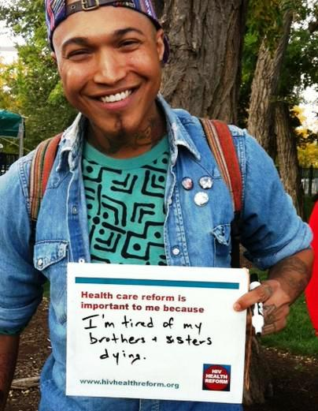
Resources
Project Inform – www.projectinform.org
NASTAD – www.NASTAD.org
Treatment Access Expansion Project – www.taepusa.org
Families USA – www.familiesusa.org
National Health Law Program – www.nhelp.org

Slide 28
Health Care Reform Planning
“If we wait for governments, it’ll be too little, too late. If we act as individuals, it’ll be too little. But if we act as communities, it might just be enough, just in time.”
Transition network
Notes:
*

