Slide 1
2012 Summit to End AIDS in America, USCA Retention in Care: Stable Housing David Vos, Director Office of HIV/AIDS Housing, HUD September 30, 2012

Slide 2

Strategic Investment in Housing
Housing is a critical component of
HIV care and prevention systems.
Helping homeless and unstably housed people:
enter into supportive housing and remain in care
reduce HIV risk behavior &
adhere to complex treatment regimens.
Addressing HIV disparities—seen in
retention in care &
delayed entry into care.

Slide 3
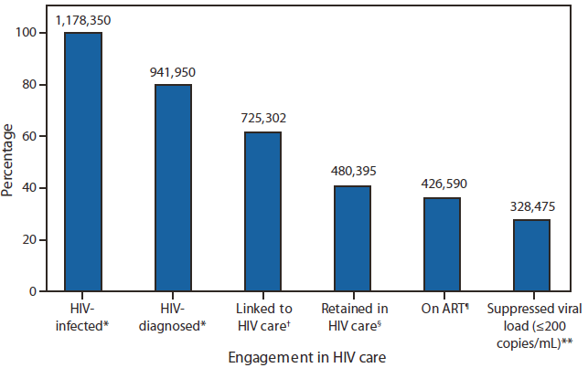
Platform to Improve Health
Address disconnects in HIV care:
80% HIV diagnosed, 62% linked, 41% retained in care, 36% on ART, 28% with optimal suppressed viral load (CDC Vital Signs, MMWR, Dec. 2011).

Slide 4
Supportive Housing Impacts
Platform to end and prevent homelessness:
Targeting – data in planning and technical assistance
Creating local synergy w. HUD & other resources
Cross program engagements involving
Health-care City/State Planning
Housing Development Community Development
Employment Operational Management
Veterans Finance
Social Services Stakeholders/Advisory bodies
Criminal Justice Public Oversight

Slide 5
Rapid Rehousing & Homelessness
No one should experience homelessness.
Opening Doors: the Federal Strategic Plan to Prevent and End Homelessness
With over 636,000 persons who are homeless in point in time count (HUD, Annual Homeless Assessment Report, 2011), HIV status known for 3.4% of sheltered persons:
13,221 persons living with HIV/AIDS in homeless situation
Up to 91,900 PLWH estimated to have had a homeless situation in prior year:
8% in CDC Medical Monitoring Project (Sept. 2011) and 15% having some type of housing instability

Slide 6
Housing Opportunities for Persons With AIDS
HOPWA FY2012
$332 million
$298.8 m (90%)
Formula
125 grants
Project Sponsors
1,000+ nonprofits & housing agencies
$33.2 m (10%)
Competitive
28 Grants
(of 94 over 3 yrs)
Households
60,234
(inc. 93,414 persons)
Leveraged Households
39,763
www.HUDHRE.info/HOPWA section
Notes:
Changes in 2004 funding included:
~ Changes to definition of MSA by OMB
~ 11 New grantees (9 MSAs & 2 states)
~ 5 EMSAs lost direct funding but have access to other formula funding

Slide 7
HOPWA variety of housing
Tenant based rental assistance (TBRA) 49% of programs costs & 30% of Households assisted (HHs).
Community residences:
26% for permanent housing residences (12% of HHs);
11% for transitional/short-term facilities (11% of HHs),
1% in development of new units.
Short-term payments to prevent homelessness 13% of costs & 47% of HHs assisted.

Slide 8

HOPWA variety of models
HOPWA 20, Housing Innovations in HIV Care
Strategic Planning Integration of service delivery
Homeless Continuums Centralized client access
Re-entry from Incarceration Youth & Families
Behavioral health challenges Cultural competency
Faith-based & neighborhood providers Housing Authorities Rural Projects
Leveraging
Consumer Input
Employment services
Technical support

Slide 9
HOPWA Modernization Ideas
Better align HOPWA with homelessness prevention
A. Expanding Short-Term Housing Interventions.
Align with related short-term interventions & rapid rehousing
Add flexibility in rental assistance terms, ongoing assessments, support over 24 months
Collaboration with area Continuum of Care & HIV programs.
Planning, using PIT survey, bed inventory, HMIS reporting systems
Centralized intake, assessment and coordination of services
Housing stability, employment & greater self sufficiency
Connections in using DHHS core indicators of HIV care.

Slide 10
Housing Status - Core Indicator
Percentage of persons with an HIV diagnosis receiving HIV services who were homeless or unstably housed
(last 12-months; along with 6 testing and care indicators; consistent with HMIS data standards).
literally homeless
(e.g., lack a regular nighttime residence, staying in an emergency shelter)
imminently losing housing
(e.g., being evicted or being discharged from an institution with no housing options identified);
unstably housed and at-risk of losing housing
(e.g., temporarily doubled up with others, moving frequently for economic reasons), and
stably housed.

Slide 11
HOPWA Information
HOPWA documents, grantee profiles, on-line financial management training, oversight/desk guide and links to webinars & eLearning resources and locate Local HOPWA/HIV services info
www.HUDHRE.info/HOPWA section
on the Homelessness Resource Exchange
www.OneCPD.info new resource exchange site & OneCPD mailing list updates
Email to HOPWA@hud.gov

