Slide 1

Private HIV/AIDS Funding in 2011

Slide 2
Private HIV/AIDS Funding in 2011
$491 million disbursed to HIV/AIDS
By 274 U.S.-based funding organizations
For 5,561 AIDS-related grants
Concentrated at the top
3% increase from 2010-2011 largely driven by 3 top 10 funders: Gates, M.A.C AIDS Fund, and ViiV Healthcare
The top 10 accounted for 80% of total disbursements (Gates alone = 49%)
Global Dominance
80% of funding directed to epidemic outside of the U.S.
2012 forecasted to remain roughly the same
According to 45% of top funders, including Gates and 4 other top 10 funders
Source: FCAA. U.S. and European Philanthropic Support to Address HIV/AIDS in 2011. To be published Nov. 2012
Notes:
In 2011, 274 Private funders in the US made over 5,500 grants totaling nearly $500M
A 3% increase over 2010 was driven by three leading funders: BMGF, MAC, and ViiV – important to note that 60% of funders decreased funding in 2011. Concentration among few funders continues with 10 funders accounting for 80% of funding
80% of funding from US funders was directed to international efforts
2012 funding expected to remain roughly the same

Slide 3
Domestic Trends
Largest number of funders, but lowest $$
While 72% of funders include a domestic focus, domestic disbursements represent only 20% of total giving (3% decrease from 2010)
Top 10 U.S. Domestic funders represented 67% of domestic funding
Prevention up
Top intended use of domestic dollars went to (in rank order): Prevention (15% increase over 2010), Treatment, and Social Services
The U.S. South
Funding on the rise from $23 million in 2009 to $28 million in 2011.
Top 5 target populations
African Americans, MSM, Women, Homeless/Impoverished and PLWHA (general)
Notes:
Looking at domestic funding only, we see that while most funders do fund in the US, only 20% of the overall funding is directed domestically
Funding has increased for prevention, and the south has increased as a region – both have been critical funding gaps.
Top 10 domestic Funders:
MAC, Gilead, Broadway Cares, AIDS United, Merck, Ford, BMS, Elton John AIDS Foundation, ViiV Healthcare

Slide 4
Regional Distribution of Domestic U.S. Philanthropic HIV/AIDS Funding in 2011 (by % of total domestic disbursements)

Slide 5
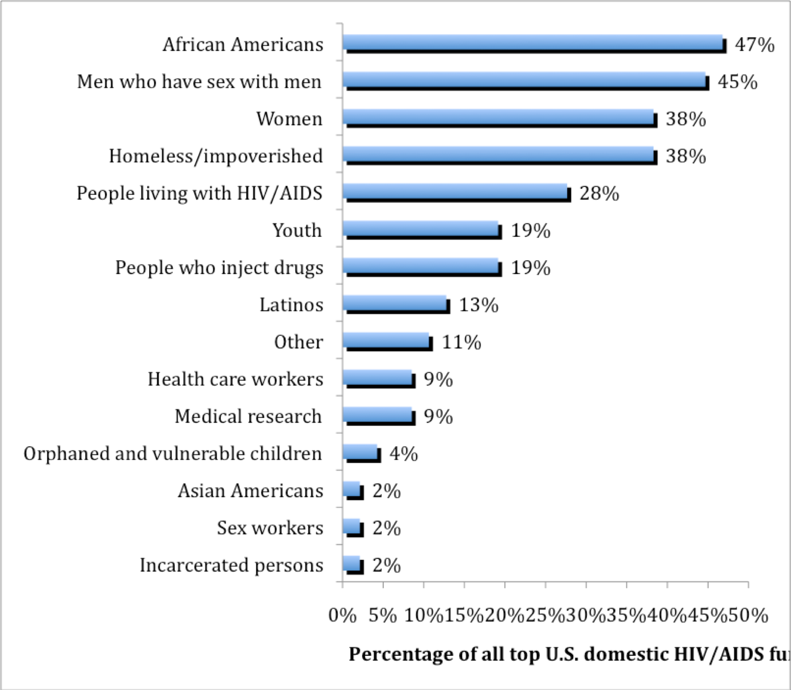
Target Populations of U.S. Philanthropic HIV/AIDS Funding for the Domestic U.S. Epidemic in 2011 (All Top Funders)
(by percentage of 47 top domestic funders from which target populations data were obtained)
Notes:
You should make note that PLWHA used to be the top priority but we asked people to be SPECIFIC (if possible), so we were

Slide 6
Intended Use of U.S. Philanthropic HIV/AIDS Funding for the Domestic U.S. in 2011
Notes:
The “other” category for domestic intended use includes funding that was unspecified and funding for projects that did not fall under the pre-determined categories, such as: health system strengthening; work against stigma; management, leadership and other organizational capacity building; assistance in streamlining business functions; technical assistance to HIV/AIDS service providers; and support of hospice care.

Slide 7
The “Other”
We use the “other” category to identify emerging trends
In 2011 $11.5 mil supported such domestic efforts as:
Stigma
Management & leadership development
Streamlining business functions
Strengthening organizational capacity
Technical assistance
Hospice care

Slide 8

The FCAA Toolkit
In 2011 FCAA developed an online toolkit in to guide funders to coordinate with the NHAS most effectively
Developed through consultation and interviews with 25 leaders in the fields of AIDS philanthropy, AIDS policy, AIDS advocacy and services
The toolkit includes 3 components:
A “101” document offering a primer on the NHAS and related public sector strategies;
Eight recommended actions for funders to help advance the goals of the NHAS; and,
Correlating examples and best practices of current funder action
The toolkit highlights videos, publications and other resources on the strategy
Online at: www.fcaaids.org/NHAStoolkit
Notes:
The FCAA toolkit, developed in response to stakeholder requests – and in consultation with various leaders in the field – provides a general overview of the NHAS, as well as recommendations for and examples of funder action and best practices.
101 includes:
Provides overview on:
Origins
Structures & goals
Social Innovation Fund
The CDC’s 12 Cities Project
NHAS & Public policy
Evaluation
Information on statewide plans

Slide 9
Recommended Funder Actions
Link funding to NHAS Goals
Fund advocacy
Build leadership & capacity
Fund research that helps the NHAS
Help evaluate the impact of the NHAS
Convene & engage other funders
Help grantees navigate sea changes
Join public-private partnerships
Notes:
The numerous interviews we did led us to these recommended funder actions, on each of which I’ll go into a little more detail.
(read the list)

Slide 10
Examples: Link Funding
In July 2012 Merck Company Foundation announced its new $3 mil HIV Care Collaborative to connect PLWHA to care, using innovative model programs in Atlanta, Houston and Philadelphia.
In May 2012 Kaiser Permanente launched a new grant strategy and RFP focused on supporting nonprofit organizations to prevent new HIV infections, identify HIV+ patients sooner, and link and retain them in care.
In 2011 Elton John AIDS Foundation began tracking their applicants’ relationship to the NHAS by asking if their programs aim to reach the same goals of the strategy (lower infection rates, increasing proportion of newly diagnosed to care, etc.).
Notes:
Here are some examples of how funders have linked funding to the NHAS

Slide 11
Examples: Fund Advocacy/Research
In 2011, AIDS United funded Strengthening Advocacy Capacity in the State of Alabama in order to build advocacy bench strength in an under-resourced area.
In 2010 as part of its special initiative focused on young MSM of color, M.A.C AIDS Fund awarded a grant to Emory University to support an adaptation of a couples HIV counseling and testing (CVCT) for male couples, developed in response to the rising rates of HIV infection among MSM in the U.S.
Notes:
Private funding represents only a small percentage of funds available for HIV related efforts. As such, it’s important to leverage these resources in ways that maximize impact by moving public funds in the right directions. These are some examples of advocacy and research funding that seeks to advance the goals of the strategy.

Slide 12
NHAS-related trends
We see funders:
Implementing new guidelines to track or prioritize grantee relationships to the NHAS
Prioritizing programs that focus on routine HIV testing and early treatment initiation
Supporting health reform advocacy (nat’l and state/regional levels)
Looking for innovative access to care initiatives, particularly those that feature cross-issue/sector collaborations (broader health, housing, mental health, LGBTQ services, etc).
Notes:
Via toolkit and RT survey

Slide 13
