Slide 1

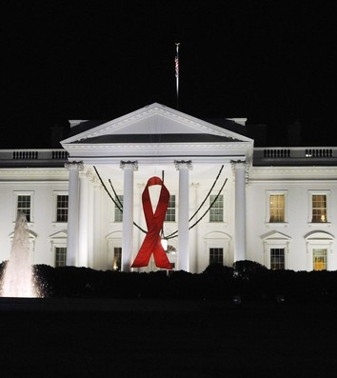
Overview of National HIV/AIDS Strategy Implementation U.S. Conference on AIDS October 1, 2012 Grant Colfax, MD Director, Office of National AIDS Policy Domestic Policy Council The White House

Slide 2
The National HIV/AIDS Strategy Overview
Goals
Reduce the number of people who become infected with HIV
Increase access to care and optimize health outcomes for people living with HIV
Reduce HIV-related health disparities
Achieving a more coordinated national response to the HIV epidemic
Facets of the Strategy
Small number of action steps
5-year targets
Emphasis on evidence-based approaches and populations at greatest risk
Multiple Federal agencies charged with Strategy implementation: HHS, HUD, VA, DOJ, DOL, SSA; HHS lead coordinating agency.
Roadmap for all public and private stakeholders responding to the domestic epidemic
Focus on improving coordination and efficiency across and within Federal, state, local and tribal governments
Catalyst for all levels of government and stakeholders to develop their own implementation plans for achieving their goals
Emphasis on concentrating efforts where HIV is most concentrated and in populations with greatest disparities, including: MSM, people of color, and transgender individuals.

Slide 3

Achieving the goals of the Strategy
Guiding Principles
Align resources with epidemic
Shared responsibility
Accountability
Evidence-based approach

Slide 4
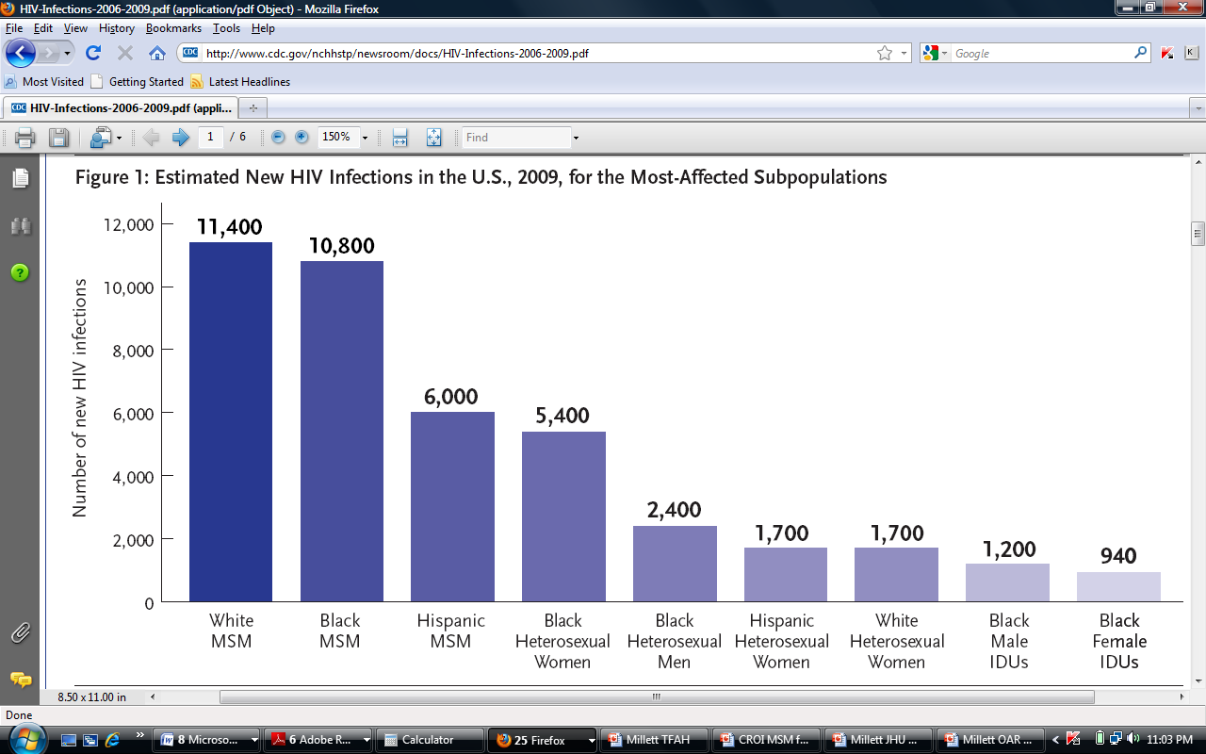
New HIV Infections in the U.S.
Estimated 50,000 new HIV infections annually in U.S.
Women comprise 23% of new HIV infections
Black women most impacted among all women
Latinas disproportionately impacted compared to whites
(Prejean et al., 20011)
Notes:
MSM and racial minorities disproportionately impacted
Only population where HIV incidence is increasing

Slide 5
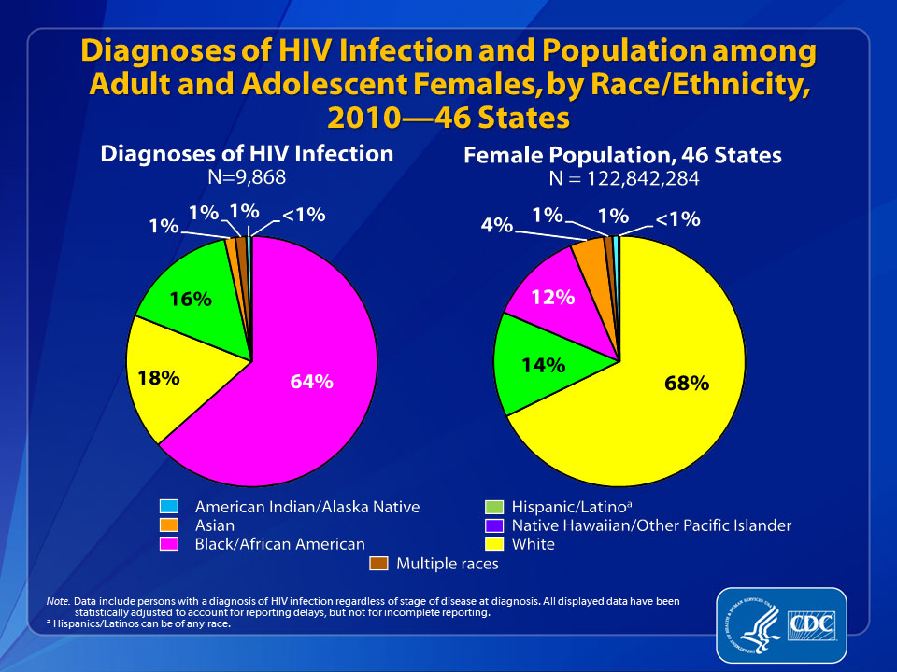
2007-2010: CDC reported 13% decrease in HIV diagnoses and 11% decrease in AIDS diagnoses among women
Notes:
The pie chart on the left illustrates the percentage distribution of diagnoses of HIV infection among adult and adolescent females in 2010 by race/ethnicity in the 46 states. The pie chart on the right shows the distribution of the female population of the 46 states in 2010.
In 2010, black/African American females made up 12% of the female population in the 46 states but accounted for an estimated 64% of diagnoses of HIV infection among females. Hispanic/Latino females made up 14% of the female population in the 46 states but accounted for 16% of diagnoses of HIV infection among females. White females made up 68% of the female adult and adolescent population in the 46 states but accounted for 18% of diagnoses of HIV infection among females.
The following 46 states have had laws or regulations requiring confidential name-based HIV infection reporting since at least January 2007 (and reporting to CDC since at least June 2007): Alabama, Alaska, Arizona, Arkansas, California, Colorado, Connecticut, Delaware, Florida, Georgia, Idaho, Illinois, Indiana, Iowa, Kansas, Kentucky, Louisiana, Maine, Michigan, Minnesota, Mississippi, Missouri, Montana, Nebraska, Nevada, New Hampshire, New Jersey, New Mexico, New York, North Carolina, North Dakota, Ohio, Oklahoma, Oregon, Pennsylvania, Rhode Island, South Carolina, South Dakota, Tennessee, Texas, Utah, Virginia, Washington, West Virginia, Wisconsin, and Wyoming.
Data include persons with a diagnosis of HIV infection regardless of stage of disease at diagnosis. All displayed data are estimates. Estimated numbers resulted from statistical adjustment that accounted for reporting delays, but not for incomplete reporting.
Hispanics/Latinos can be of any race.

Slide 6
HIV Health Outcome Disparities for:
Excess deaths, for blacks compared to whites
Life expectancy losses, for Latinos compared to blacks or whites
Time to AIDS and death after AIDS diagnosis, for black and Latino MSM relative to white MSM
Life expectancy losses, for Latina and black women compared to white women
Hall et al, Am J Public Health. 2007 Jun;97(6):1060-6
Levine RS et al, Am J Public Health. 2010 Nov;100(11):2176-84
Losina E et al, Clin Infect Dis. 2009 Nov 15;49(10):1570-8
Notes:
Disparities we see in incidence - - also reflected in health outcomes for persons living with HIV

Slide 7
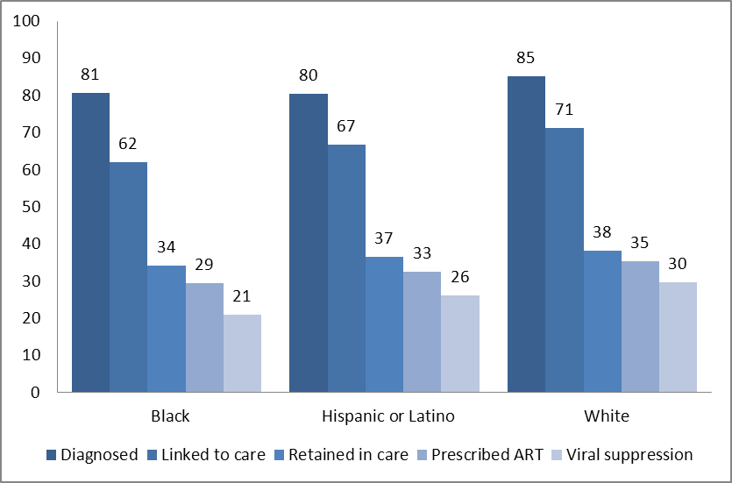
Percentage of persons with HIV engaged in selected stages of the continuum of care, by race/ethnicity – United States
Hall et al, IAS, July 27, 2012
Notes:
The percentage of blacks and Hispanics aware of their infection was somewhat lower than among whites,
and the percentage linked to care, retained in care, presecribed ART and with suppressed viral load was also lower among blacks compared with whites. Among blacks, 21% had a suppressed viral load compared with 30% among whites.
Among Hispanics, the percentage retained in care and prescribed ART was similar to that among whites; however, a somewhat lower percentage had a suppressed viral load.

Slide 8
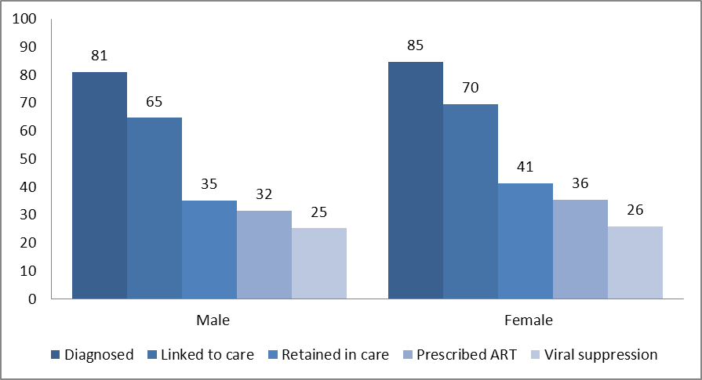
Percentage of persons with HIV engaged in selected stages of the continuum of care – United States
Hall et al, IAS, July 27, 2012
Notes:
Here we see the continuum of care for males and females.
While there are some difference in awareness status and linkage and retention in care, with women doing slightly better
The percentage of males and females that had a suppressed viral load was similar.

Slide 9
A Higher Bar: Inclusive Treatment Recommendations
Spring 2010: SFDPH recommends offering treatment to all persons living with HIV
December 2011: NYC DOHMH recommends offering treatment to all
March 2012: HHS panel recommends offering treatment for all
July 2012: D.C. DPH recommends offering treatment to all
July 2012: IAS recommends offering treatment to all
Notes:
In the last few years, robsust evidence shows earlier treatment is beneficial for people living with HIV.

Slide 10
96%
Results of the HPTN052 trial show that if a person living with HIV adheres to an effective antiretroviral therapy regimen, the risk of transmitting the virus to their uninfected sexual partner can be reduced by 96%
Cohen et al, NEJM, 2011

Slide 11
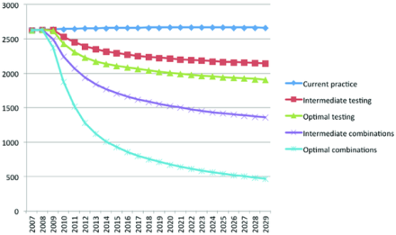
Increasing testing and treatment to achieve the Strategy’s goals
Sorensen, PLoSOne, 2012

Slide 12
Making Smarter Investments: CDC Modeling for Philadelphia
Untargeted interventions | Cost per new infection averted (rank)
Testing in clinical settings | 51,293 (3)
Partner services | 99,105 (7)
Linkage to care | 114,644 (8)
Retention in care | 75,665 (5)
Adherence to ART | 42,753 (2)
Targeted interventions | HRH | IDU | MSM
Testing in non-clinical settings | 866,272 (12) | 53,935 (4) | 17,965 (1)
Behavioral intervention for HIV+ people | 594,796 (10) | 700,005 (11) | 97,410 (6)
Behavioral intervention for HIV- people | 15,642,127 (14) | 2,931,406 (13) | 327,210 (9)
ART, Antiretroviral therapy
HRH, High risk heterosexuals
IDU, Injection drug users
MSM, Men who have sex with men
Sansom et al, CDC Grand Rounds August 21, 2012
Notes:
SO how do we make smarter investments in care and prevention? As part of NHAS implementation, CDC has been conducting analyses to answer this question with regard to preveniton interventions. This is a model based on investments in Philadelphia. As you can see…
Here are our modeling results of cost per infection averted for each prevention intervention and risk group.
On the top, are interventions typically delivered to all. On the bottom, are interventions typically targeted by risk group.
[CLICK] Testing of men who have sex with men in non-clinical settings, such as from mobile vans, ranked #1 at about $18,000.
[CLICK] Behavioral interventions for uninfected heterosexuals at high risk of infection ranked last costing more than $15 million per case averted.
Note that testing, care and treatment interventions tended to rank higher than behavioral interventions Given HIV lifetime treatment costs of $391,000, many of these interventions are cost-saving.

Slide 13
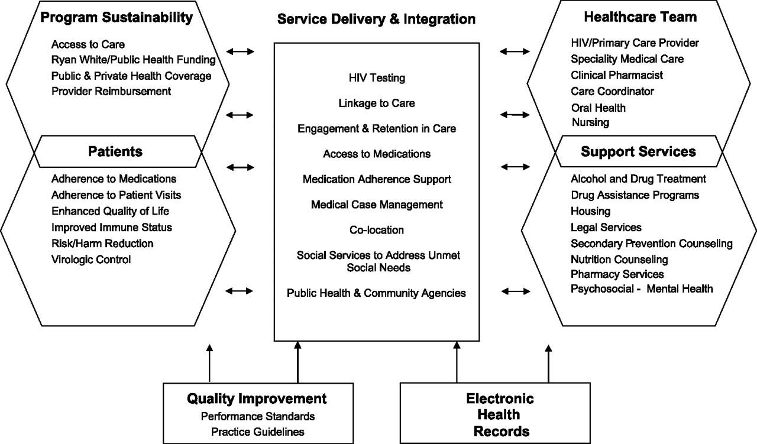
Maximizing the Cascade: Components of Comprehensive HIV Care
Gallant et al. Clin Infect Dis. 2011
Notes:
Essential components of HIV care. Abbreviation: HIV, human immunodeficiency virus.
HIV medicine has developed an extrememely successful, integrated model for chronic disease management, often with an interdisciplinary, integrated approach to improve HIV outcomes. Recommend reviewing this aricle by Gallant et all which details the critical components of the HIV care system.

Slide 14
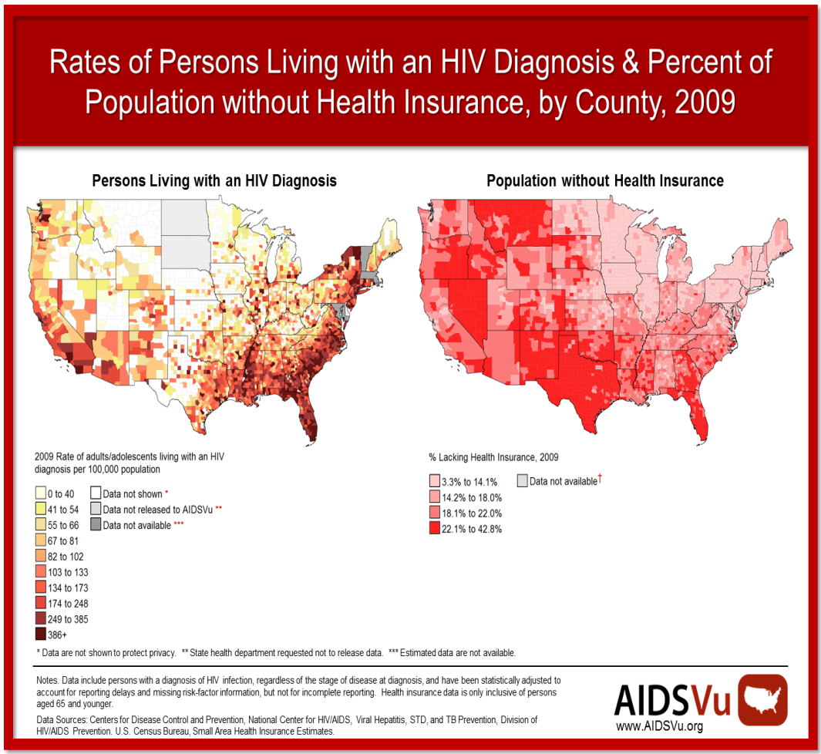
HIV and Health Coverage
Of U.S. PLWHA, approximately:
13% have
private coverage
24% have no coverage
47% receive Medicaid
Over 500,000 receive some form of
Ryan White services
HRSA, http://www.healthcare.gov
Kaiser Family Foundation; aidsvu.org
PLWHA, Persons living with HIV/AIDS

Slide 15
Kaiser Cohort Study
KP Northern California cohort study of people living with HIV
Black and Latino patients more likely to live in census tracts characterized by lower education and SES
Latinos had less access to public health insurance
ART adherence over 2 year period highest among whites compared with blacks or Latinos
Mean CD4 highest among whites compared to blacks or Latinos
How did this translate into AIDS-related events or death?
Slide courtesy of G. Millett

Slide 16
Time to AIDS-Related Events or Death
 | HR | (95% CI) | P
White | 1
Black | 1.2 | (0.9-1.5) | 0.25
Hispanic | 0.8 | (0.6-1.1) | 0.17
 | HR | (95% CI) | P
White | 1
Black | 1.1 | (0.9-1.4) | 0.27
Hispanic | 0.7 | (0.5-0.9) | 0.01
Silverberg, et. al., J Gen Intern Med. 2009;24(9):1065-72
Notes:
KP bucking national trends for AA

Slide 17

Toward Health Equity: The Affordable Care Act
Expands coverage to over 30 million Americans
12.9 million Latinos will have access to coverage
7.3 million African-Americans will have access to coverage
Source: Office of the Assistant Secretary for Planning and Evaluation, 2012

Slide 18
The Affordable Care Act: Meaningful Change Now
54 million additional Americans receiving preventive services
More than 3 million young adults insured by remaining on parent’s private insurance
Eliminated lifetimes limits for 105 million Americans
Hundreds of persons living with HIV now covered under Pre-existing Condition Insurance Plans
ADAP benefits considered contribution toward true out-of-pocket expenses, helping fill “donut hole”
Insurers cannot rescind coverage except in cases of fraud or intentional misrepresentation
Expanded National Health Service Corps
3600 providers (2008) to 10,000 (2011)
Increased patients served from 3.7 to 10.5 million

Slide 19
Affordable Care Act: 2014
No denial of coverage for pre-existing conditions (includes HIV)
Expands Medicaid eligibility to 133% of Federal poverty level
Creates affordable insurance exchanges with a choice of private insurance plans and with tax credits to make coverage affordable
Increased resources to community health centers ($11 billion over 5 years)

Slide 20
Examples of women-specific benefits and the Affordable Care Act
47 million women now have guaranteed access to additional preventative services without cost sharing, including:
Well-woman visits
HPV DNA testing
STI counseling
HIV screening and counseling
Interpersonal and domestic violence screening and counseling
Insurers will not be able to deny coverage to women based on pre-existing conditions, including pregnancy
Insurers will not be able to charge women higher premiums than men

Slide 21
HIV Tracks with Social and Economic Disparities HIV Infection Among Heterosexuals in Urban Areas, by Socio-Economic Indicators
CDC. Characteristics Associated with HIV Infection Among Heterosexuals in Urban Areas with High AIDS Prevalence --- 24 Cities, United States, 2006--2007. MMWR 2011;60:1045-1049.
Notes:
Access to healthcare is a gateway to health and wellness, and the ACA is transformative in that regard. Social determinants of health are also critcially important to HIV prevention and care, and must continue to be recognized and addressed in the broader context of peoples lives.
HIV prevalence was higher among those with lower socioeconomic status (SES), NHBS MMWR
24 Cities, United States, 2006--2007

Slide 22
Supporting a combination approach to the epidemic…
Coates. Lancet, 2008

Slide 23


For Updates and More Information:
http://www.whitehouse.gov/administration/eop/onap
AIDS.gov
www.healthcare.gov

Slide 24


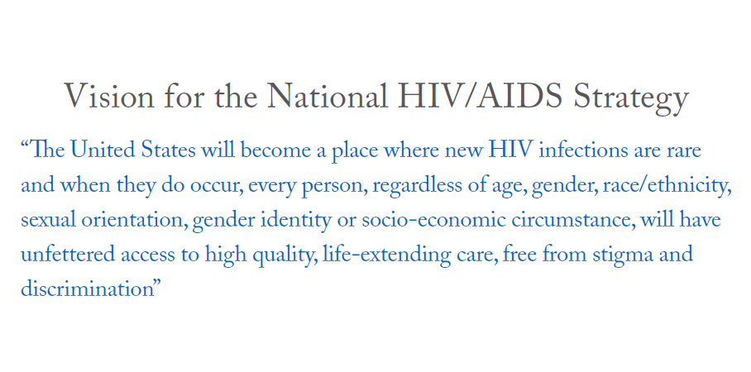



Slide 25
Acknowledgements
HHS: Ron Valdiserri, Howard Koh, Greg Millet
ONAP team: James Albino, Aaron Lopata, Rob Mesika, Helen Pajcic

