Slide 1
Summit to End AIDS in America
September 29, 2012
Las Vegas, NV
DeAnn Gruber, PhD
Administrative Director
Louisiana OPH STD/HIV Program
Notes:
1

Slide 2



A Collaborative Initiative funded in part by:
HRSA HIV/AIDS Bureau
Office of Science and Policy
Special Projects of National Significance

Slide 3

Louisiana Public Health Information Exchange (LaPHIE)
A carefully designed two-way electronic information exchange
Uses OPH surveillance data to generate point of care messages for providers in the LSU HCSD (public hospital) system in Louisiana
Targets patients with HIV, TB, syphilis who have fallen out of care, or never received test results, as well as perinatally HIV-exposed infants needing follow-up
Notes:
3

Slide 4
LSU Health Care Service Division
Hospitals
Notes:
HPL is not shown on this map – but it is part of LaPHIE.

Slide 5

LaPHIE - Surveillance Data Inputs
Filtered dataset after business rules applied
HIV Surveillance Database
Laboratory Database
Target populations:
Persons considered “not in care”
(no record of CD4/VL in 12 months)
Persons who have not received test results and may be unaware of HIV status
HIV-exposed infants in need of follow-up
LaPHIE Server
LaPHIE Database
Communication system:
MIRTH – open source
(behind OPH firewall)
Notes:
A carefully designed bi-directional electronic information exchange linking public health and the LSU HCSD (public hospital) system
Uses OPH surveillance data to generate point of care alert messages in real time for providers in 7 hospitals and their affiliated ERs, inpatient units and ambulatory clinics.
Targets patients with HIV, TB, syphilis who have fallen out of care, or never received test results, as well as perinatally HIV-exposed infants needing follow-up
Briefly, OPH populates a dataset nightly with those out of care per LaPHIE criteria (figure on right). As a patient registers at a participating LSU facility (top left), his/her identifying information is immediately and securely transmitted to OPH and “bounced off” the dataset to see if there is a match. If so, a standardized message is immediately returned which will appear in the patient’s electronic medical record when it is accessed by an authorized clinician at the point of care.

Slide 6


LaPHIE - Current Configuration
Admission Information
Admission Information (ADT)
Registration
Disease Alert (PPR)
Disease Alert Response (PRR)
Disease Alert
Disease Alert Response
LaPHIE Server
Interface Engine
EMR
Office of Public Health Firewall
LSUHCSD Firewall

Slide 7
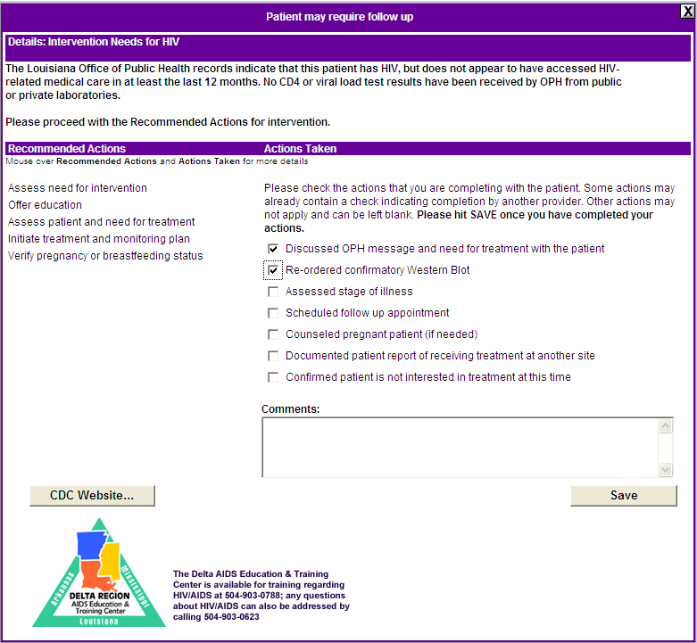




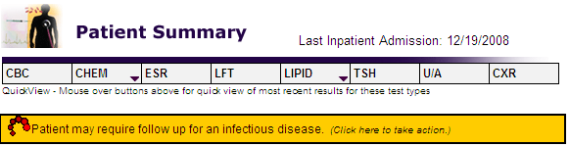
How LaPHIE Works…
Physician follows on-screen steps to re-engage patient into care and provide HIV treatment, as appropriate
Real time communication with surveillance system alerts physician that patient needs attention for HIV/AIDS
Patient comes to clinic, hospital, or ED for non-HIV service
HIV clinic
Notes:
This slide has animation!!! Need to click through to get to next step. Provide concrete example here: person comes into ED with broken toe, identified as having been out of care (sans viral load & CD4 x 2 years) person re-engaged in-care, referred for treatment at HIV specialty clinic, then followed.

Slide 8
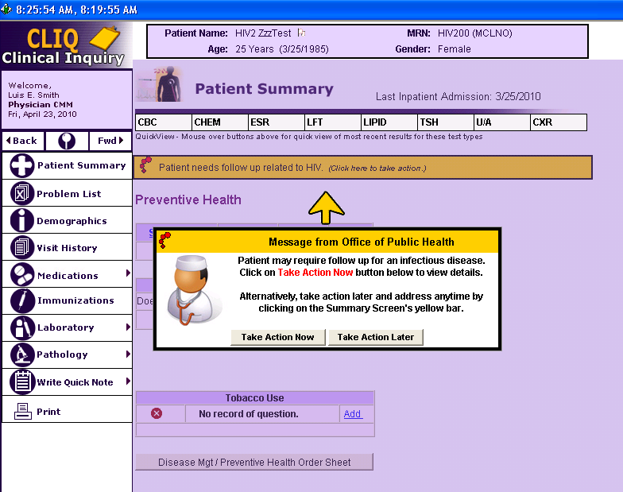
Disease Alert Component
Notes:
8

Slide 9
How did we get where we are today?
  Assessed and modified technical infrastructure
  Designed messaging with iterative prototype process
  Established partnership, governance and agreements
  Conducted consumer research
  Participated in an ethics review by national experts in biomedical ethics, public health ethics and AIDS privacy
  Requested a legal review of legislation related to sharing of public health information
  Raised community awareness and readiness
  Prioritized open dialogue and established feedback mechanisms
Notes:
Or the “change ‘don’t’ come easy” days…
Cultivating the “invisible infrastructure” – this isn’t just an IT project
Stewardship of information – what can and can’t be shared – better understanding of the laws as well as consideration of minimum necessary.
Communication – among partners and with the community. Transparency and Readiness to go public with potentially controversial model
Change management
Mindfulness of patients and patient concerns from qualitative research
“invasion of an individual’s right to privacy’ and you can’t do that… then well maybe you can legally, but it will be a public relations nightmare. Shifting the paradigm
Openness around purpose, design and evaluation findings
Cautious optimism, recognition of any partner’s concern – value of neutral convener.
Recognizing people will need to fully understand the model and see the outcomes before supporting.

Slide 10
Considerations Using
Surveillance Data
Essential questions:
We have the information and the technical ability to inform clinicians about patients in need of care … BUT SHOULD WE?
Would this be accepted by patients, providers, and the public?
Do state laws and regulations allow the proposed information exchange?
Is surveillance data reliable as a basis for clinical interventions?
Can we adequately address security/privacy concerns?
Considerations:
Legitimate public health purposes
Respect rights of individuals and communities
  Seek input from those to be impacted
  Minimize undue burden
Privacy and security standards

Slide 11
Preliminary Results
2/1/09 through 1/31/12
Notes:
11

Slide 12
Messages through LaPHIE
825 alerts sent across system of which 719 (86%) were seen by a provider
Among 547 unduplicated HIV patients with records alerted in system, 447 (82%) had any action taken
Of all identified people
  82% had at least one CD4 or viral load over follow up
Among those followed at least 12 months (n=418)
  84% had at least one CD4 or viral load over follow up
Source: Activity
Notes:
Note: this slide is by alert not by person
. Of those seen,
659 (79%) < 2 hour delay
51(6%) >2 hour and < 8 hour delay
9 (1%) >8 hour delay
31 (4%) seen by provider where clinic code is ORX
6 (19%) of these had action taken
12

Slide 13
Acceptability
Substantial formative and evaluative work with consumers demonstrated acceptability
N=24 qualitative interviews of LaPHIE identified patients
  Acceptable
  Positive experience of LaPHIE communication
  Perception that it is a “good system”
  System helped re-engage in care
No negative calls to OPH hotline
Provider ease of use, acceptable
Source: Qualitative data
Notes:
Can note provider follow up surveys pending
13

Slide 14
conclusion
Using LaPHIE, we were able to:
Identify over 789 (thru 9/6/2012) HIV-infected individuals who had been out of care thereby reducing missed opportunities to intervene
Offer clinical services to improve individual- and population-level health
Determine that system is acceptable to both patients and providers through feedback processes
Confirm that a well developed, stakeholder involved process promotes success in implementing novel approaches in addressing linkage and retention.
Notes:
Since LaPHIE went “live”, nearly 800 persons living with HIV who had not received HIV-related medical care for the past 12 months have been identified. It was determined that 24% had no prior labs in the OPH surveillance system, meaning that they had not received any HIV-related medical care in Louisiana.
Through the development and implementation of this process, we feel that LaPHIE is one tool to successfully offer clinical services to improve both individual- and population-level health. In addition, through the formative research activities, as well as the ongoing evaluation processes, we’ve determined that this system is a mechanism that is acceptable to both patients and providers. And finally, this process, which has been well thought-out, thorough, and collaborative including both consumers and key stakeholders, has resulted in high success.
We look forward to continuing to utilize and expand this system to other medical facilities during the upcoming year and that this system demonstrates another tool that can promote “new hope for stopping HIV”.
Replication and the SPNS grant at OLOL and HRSA initiative to 3 states to replicate LaPHIE type interventions.
I’d like to acknowledge the many, many partners who have been a part of this process, who are listed here. Thank you very much.
14

Slide 15
Acknowledgements
Patients
LSU/TU clinicians
UH Infection Control
Delta Region AETC
LSU SPH Medical Informatics & Telemedicine
HCSD CEO, CMO, CIO/CMIO
LIS Core Group
HCSD Programming Support
OPH HIV, STD and TB programs
OPH nurses
OPH epidemiologists
OPH Disease Intervention Specialists
OPH Medical Directors
DHH Legal Counsel
LPHI
Notes:
.
15

Slide 16
Contact Information
Louisiana OPH
STD/HIV Program
LSU Health Care
Services Division
DeAnn Gruber, PhD
Administrative Director
deann.gruber@la.gov
504-568-7474
Jane Herwehe, MPH
Project Coordinator
jherwe@lsuhsc.edu
504-903-3089

